Slide 1
MAJor Project-2
Project Title:-
Online Tiffin Service
Members:
Esha Mitra (201b107)
Navanshu (201b164)
Prince Katare (201b197)
Guide : Dr. Kunj Bihari Meena

Slide 2
Index
SNo. | Topic | Page No.
1. | Introduction | 1
2. | Purpose | 2
3. | Scope | 3-4
4. | Interfaces | 5-6
5. | Requirements | 7-8
6. | Software Process Model | 9
7. | Use Case Diagram | 10
8. | Data Flow Diagram | 11-12
9. | Feasibility | 13
10. | Technologies used | 14-15
11. | Snapshots | 16-23
11. | Conclusion | 24
12. | References | 25

Slide 3
Introduction
Also known as meal delivery system.
It is aimed to provide freshly prepared meals on demand.
The term tiffin was originated in India , referring to a meal packed in a compartmentalized container for portability.
Tiffin service is to emphasize the use of fresh locally sourced ingredients.
This will help the people who prefer variety, quality and health in their meal options.

Slide 4
Purpose
Offers convenience and flexibility for individuals who may not have the time to cook daily meals.
It is to aid the busy individuals, students and working professionals.
Sellers can register themselves to offer variety and specialty.
Can reach larger number of people.
Will be able to help local retailers.

Slide 5
Scope
This will help people buy their personalized meal plans.
It will be convenient and user friendly.
The users can be customers as well as sellers.
Delivery options can be flexible such as daily weekly or on demand.
Developing targeted marketing strategies to raise awareness, attract new customers, and retain existing ones

Slide 6
Scope (cont..)
The system functions and features will briefly include :
Registration of user : Login and signup (for both seller and customer)
OTP / email verification.
Search bar to search for meal plans.
Managing record of shipments by seller.
Availability of items.
Filters on available products.
Add-to-cart and adding shipment details.
Payment options.

Slide 7
Interfaces
User Interfaces
The UI will be compatible with any browser such as Chrome , Mozilla , Edge etc.
This will help the user to access the system.
Hardware Interfaces
Since the application runs over internet , the network interface is necessary such as Wi-Fi or 3G/4G internet connectivity for better experience.

Slide 8
Interfaces (cont..)
Software Interfaces
The data of the project will be maintained in a database (No-SQL ) which is MongoDB.
The MERN stack will be used a tech stack.
Communication Interfaces
We will communicate over the internet.
The UI will be displayed in English, for easy use of variety users.

Slide 9
Hardware Requirements
A Laptop / desktop with :
Minimum 512 Mb RAM
Single core 2GHz preprocessor.
Disk space of at least 2 GB required for using Visual Studio code.
(depending on the IDE and tech stack, the requirements might vary)

Slide 10
Software Requirements
For file sharing and storing :
MongoDB : database management software.
Express.js : server side development and a middleware for Node.js
React.js (HTML, CSS, JS) for UI development.
Web browsers such as Chrome , Microsoft Bing, Edge, etc.
IDE : software development environment such as Visual Studio code, JetBrains etc.

Slide 11
WATERFALL MODEL
Communication
Planning
Modelling and
Design
Development
Deployment
The waterfall model is a linear software development approach where each phase must be completed before moving on to the next.
We will work on our project in the waterfall approach.
9

Slide 12
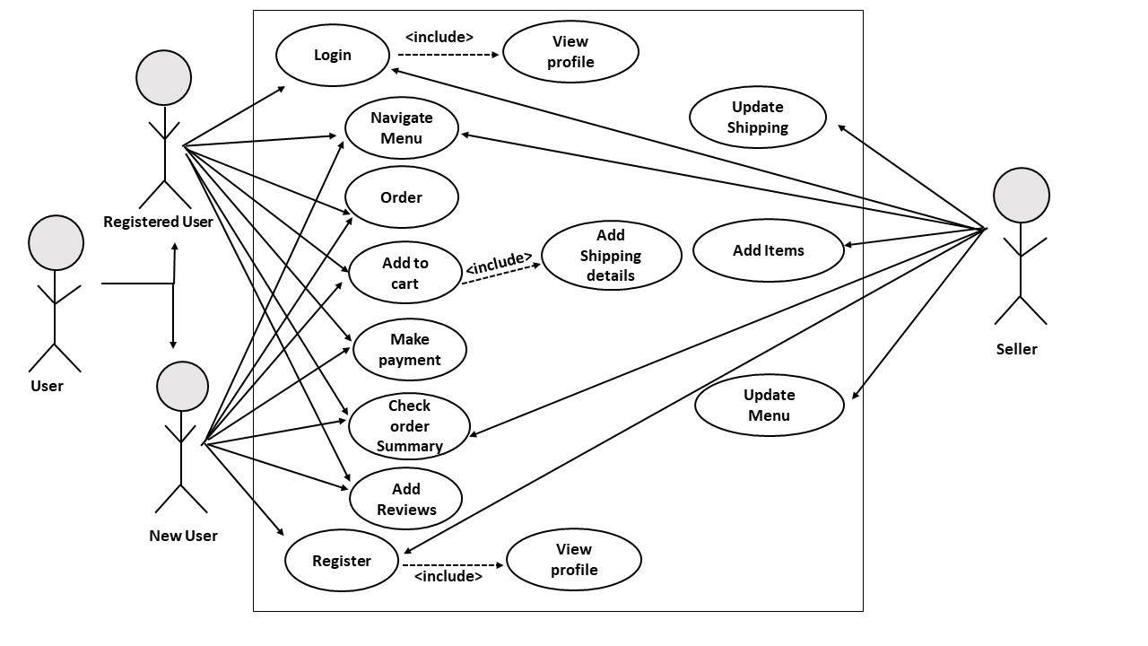
USE CASE DIAGRAM

Slide 13
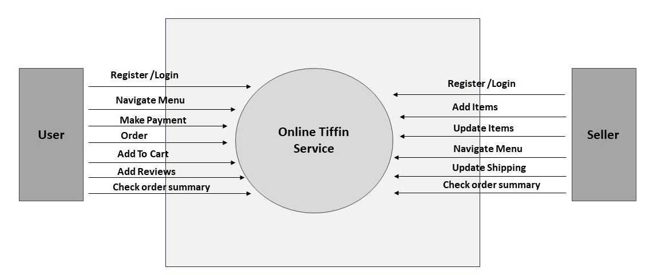
DATA FLOW DIAGRAM (LEVEL 0)
11

Slide 14
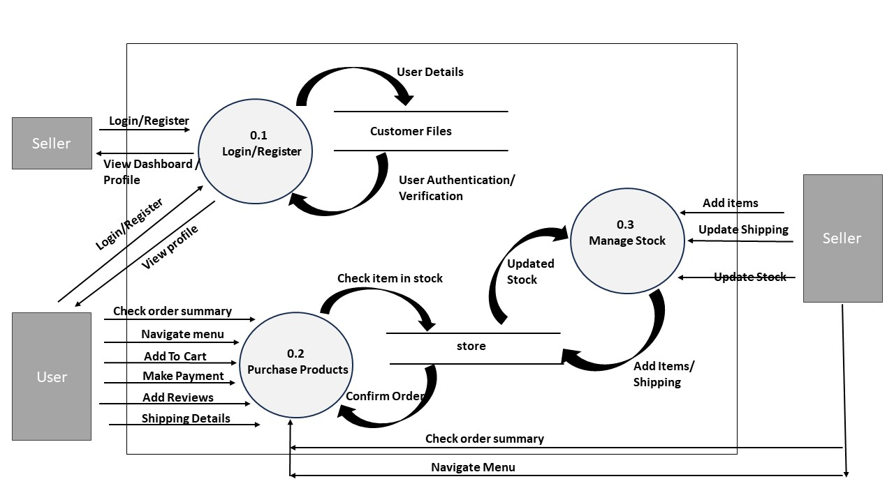
DATA FLOW DIAGRAM (LEVEL 1)
12

Slide 15
Feasibility Study
TECHNICAL
ECONOMICAL
OPERATIONAL
Project requires the knowledge of MERN stack as a whole.
Basic UI (frontend) technologies as well as database like MongoDB and express.js for server requirements.
Apart from laptop, no hardware cost is required.
No additional software purchases as well as easy to use open source applications are used.
Implementation is also comparatively easy.
Maintenance cost is negligible.
Product will be available to everyone and the interface will be easy to use.

Slide 16
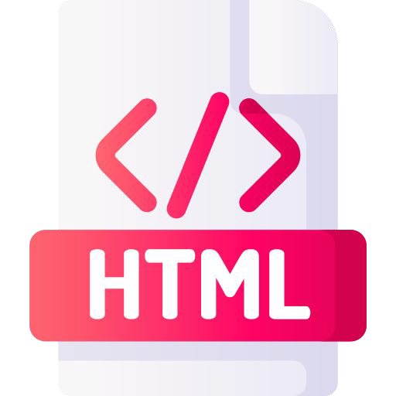
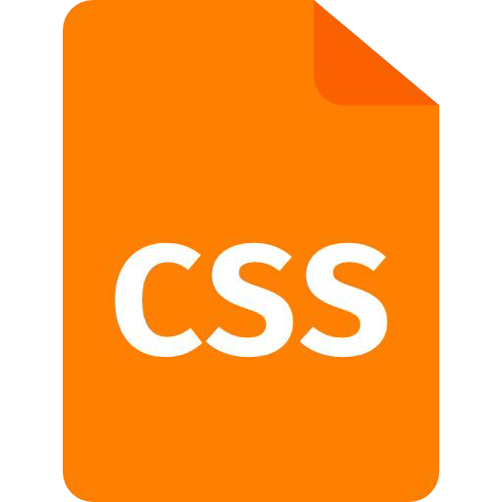


FRONTEND
The standard markup language for documents designed to be displayed in a web browser.
CSS is used to beautify the webpages.
It is a interpreted programming language used to create interactive effects within web browsers.
React.js is the JavaScript framework used as an UI tool.
14

Slide 17

BACKEND
NodeJs
ExpressJs
Using MongoDb as a database.
15

Slide 18
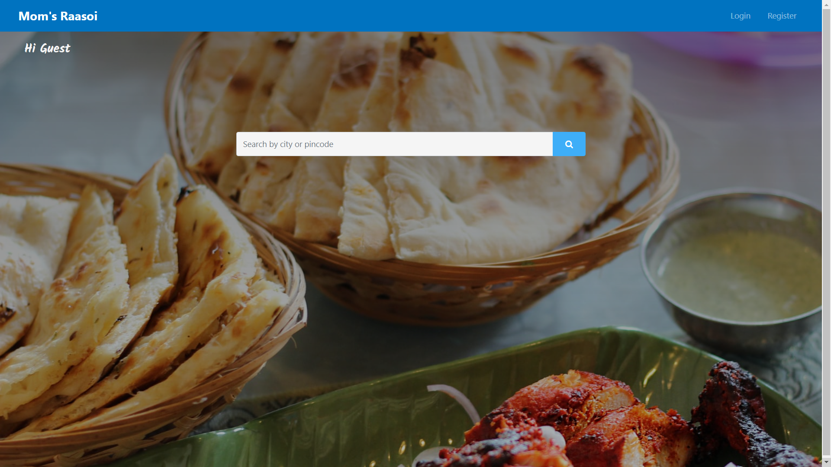
SNAPSHOTS

Slide 19
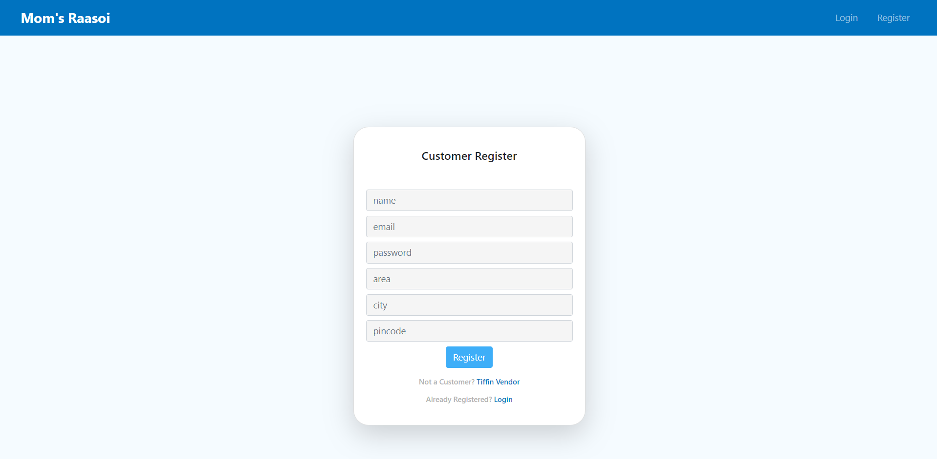

Slide 20
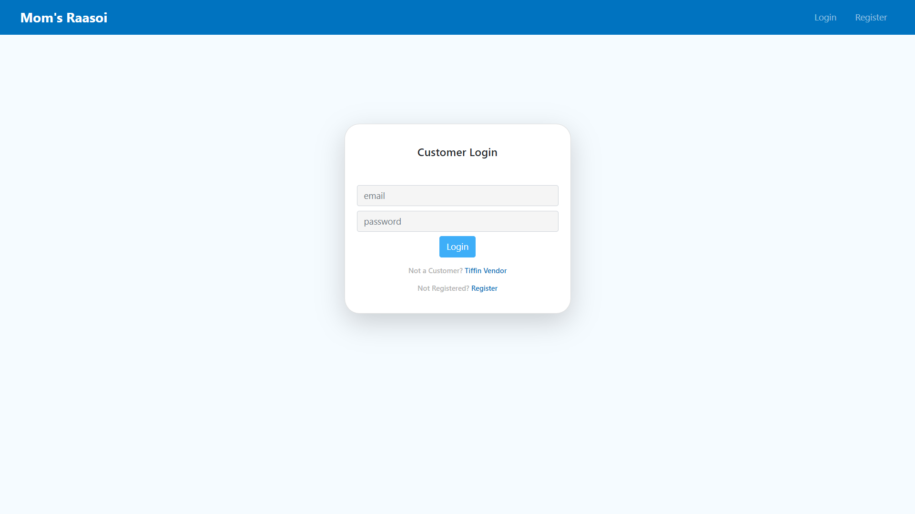

Slide 21
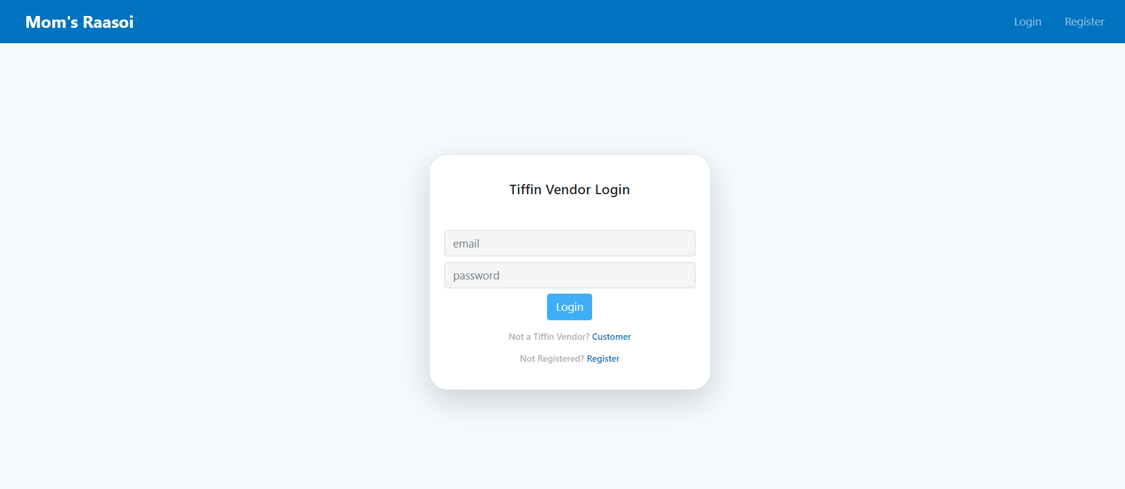

Slide 22
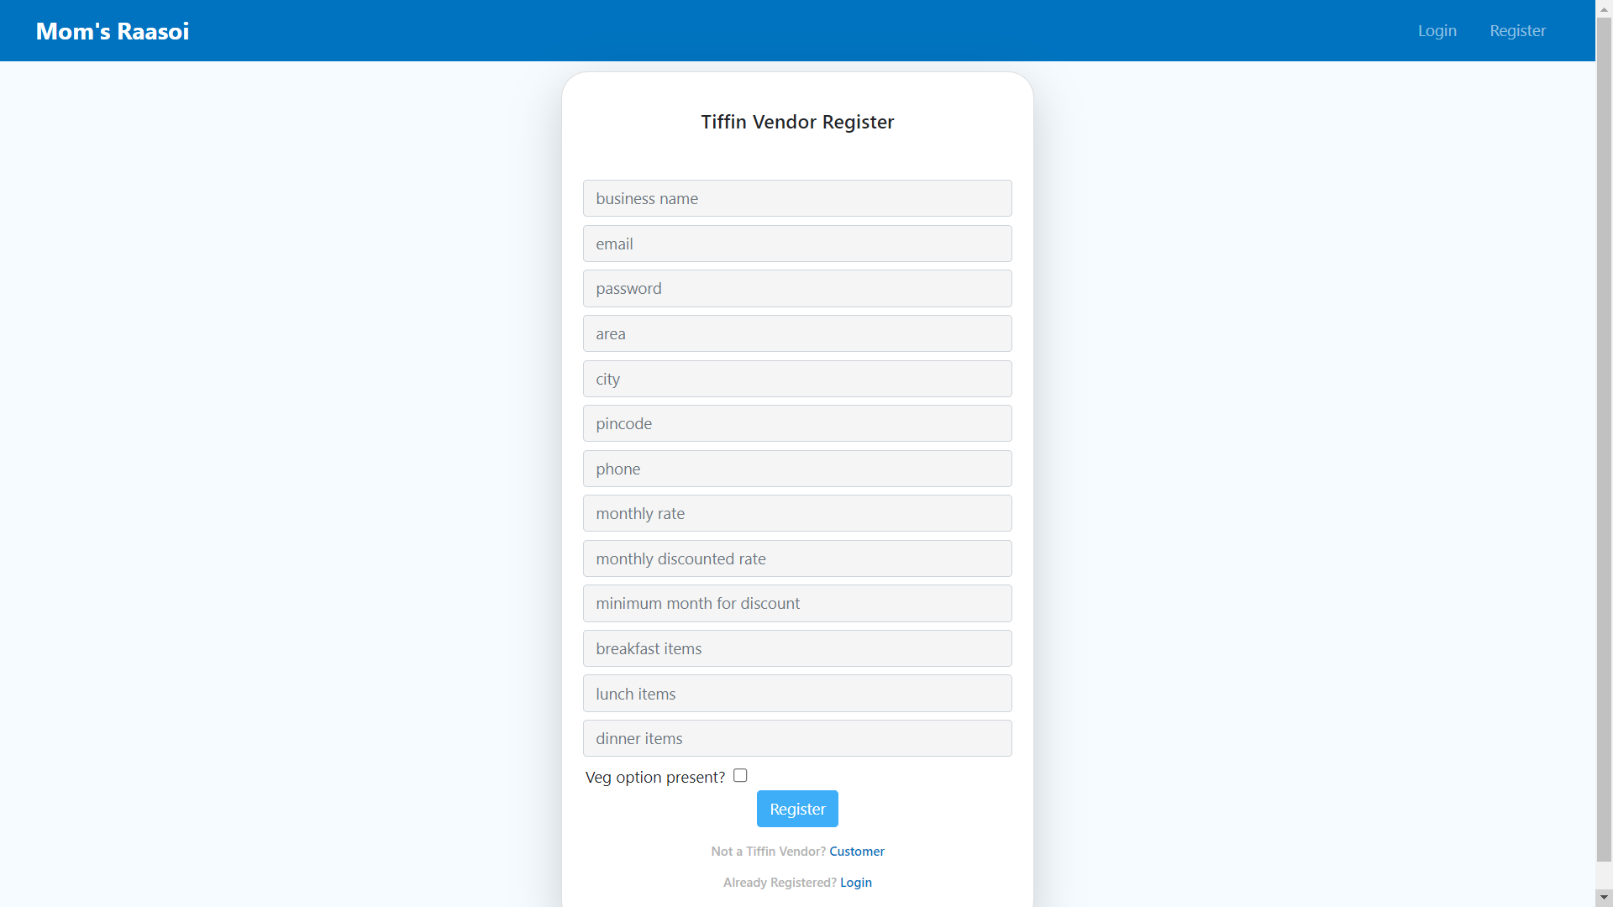

Slide 23
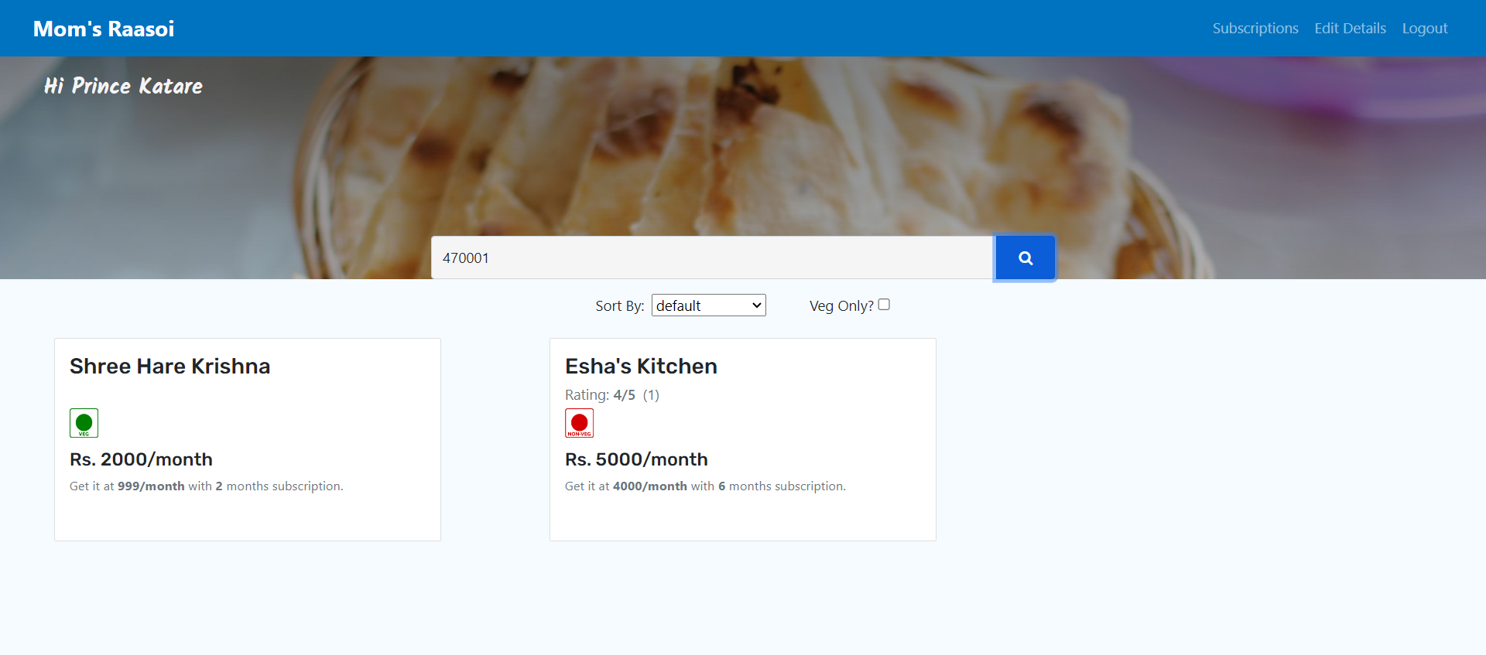

Slide 24
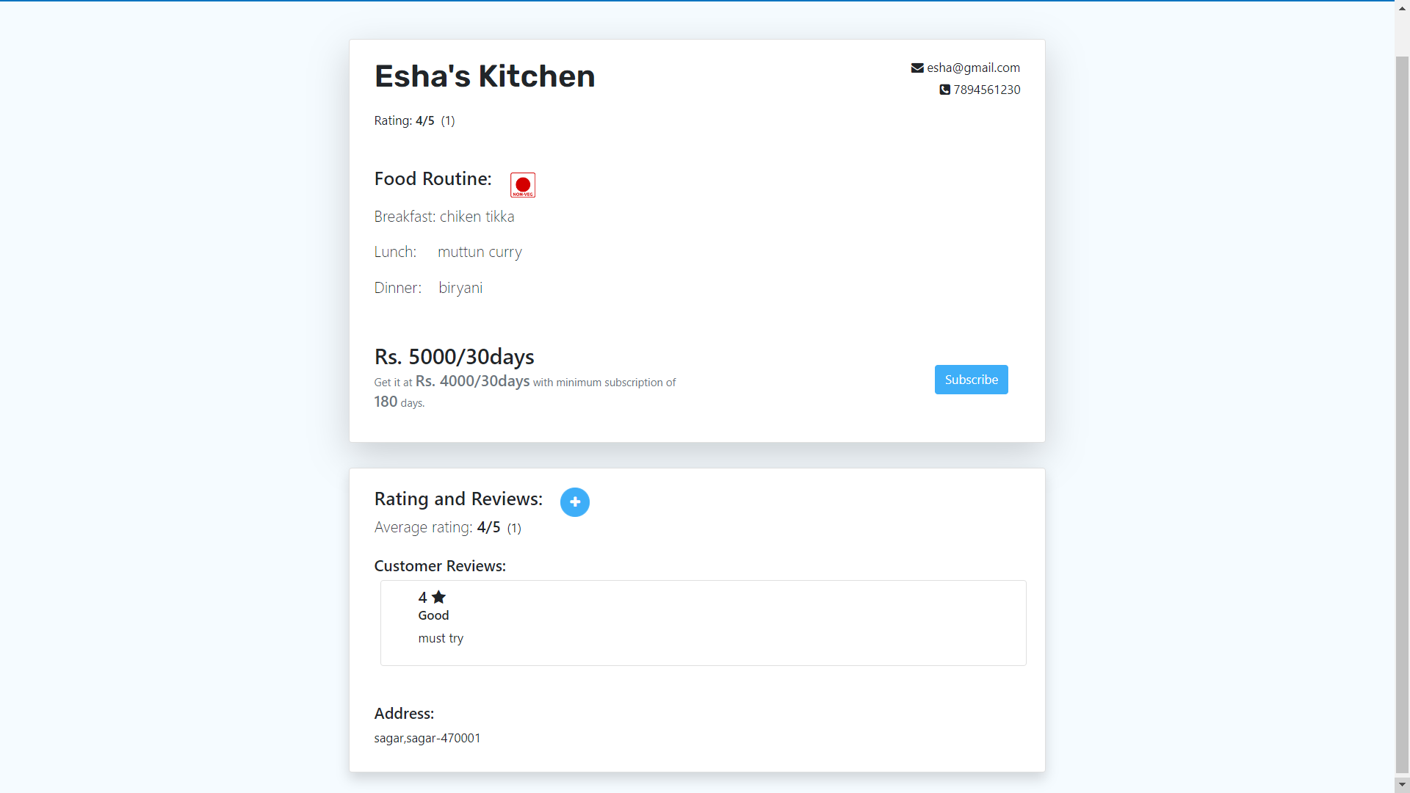

Slide 25
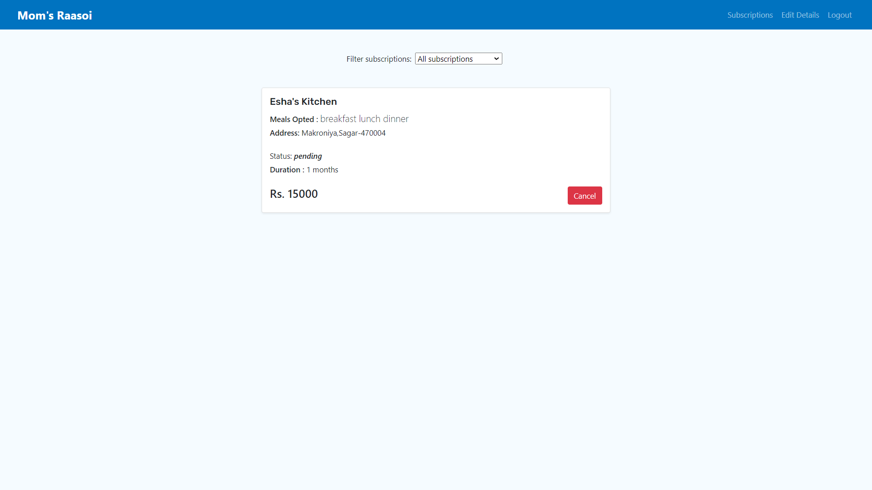

Slide 26
CONCLUSION
In conclusion, we want to develop a online tiffin service platform that will help users buy and sell meals online without third party intervention. It will be a user- friendly interface and will help in easy and fast product delivery.

Slide 27
References
[1] N. I. Naim, “ ReactJS: An Open Source JavaScript library for front-end development ,” Bachelor of Engineering , Dept. Information Technology , Metropolia University of Applied Sciences , 2017 [Accessed : 29-Jan -2024]
[2] H. Shah, “ Node.js Challenges in Implementation ,” Master of Science, Dept. Computer Science , SZABIST , Dubai , 2017 [Accessed : 8-Feb-2024]
[3] Geeks for Geeks (2022, Apr. 19). Express.js Application Complete Reference [Online]. Available: https://www.geeksforgeeks.org/express-js-application-complete-reference/ [Accessed : 12-Feb-2024]

Slide 28
THANK YOU !!

